Slide 1

Food recognition
A smart app that uses deep learning to track nutrition from food images
Done by: Jubandyqov Azamat, Nurseit Abdiraimov, Daniyar Kyzyrov

Slide 2
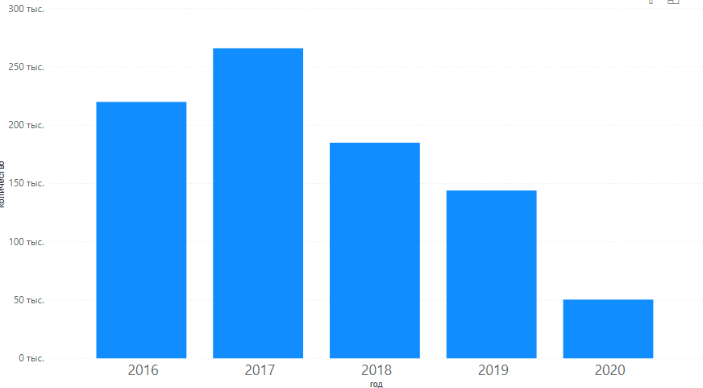
Over the past five years, 865,400 articles have been published, and for all the time more than 4.19 million papers.

Slide 3
Overview
Recognizing food from images is an extremely useful tool for a variety of use cases. It would allow people to track their food intake by simply taking a picture of what they consume. Food tracking can be of personal interest and can often be of medical relevance as well. Medical studies have for some time been interested in the food intake of study participants but had to rely on food frequency questionnaires that are known to be imprecise.

Slide 4
Datasets
ISIA Food-500
Food Recognition Challenge on Kaggle
Food Recognition Challenge on AIcrowd
The Food and Food Categories (FFoCat) Dataset

Slide 5
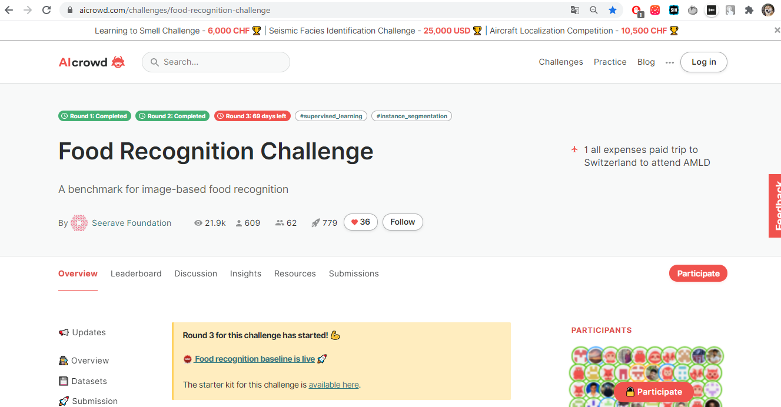
Food Recognition Challenge on AIcrowd
The goal of this challenge is to train models which can look at images of food items and detect the individual food items present in them. Finding annotated food images is difficult. There are some databases with some annotations, but they tend to be limited in important ways. To put it bluntly: most food images on the internet are a lie. Search for any dish, and you’ll find beautiful stock photography of that particular dish. Same on social media: we share photos of dishes with our friends when the image is exceptionally beautiful. But algorithms need to work on real world images.

Slide 6
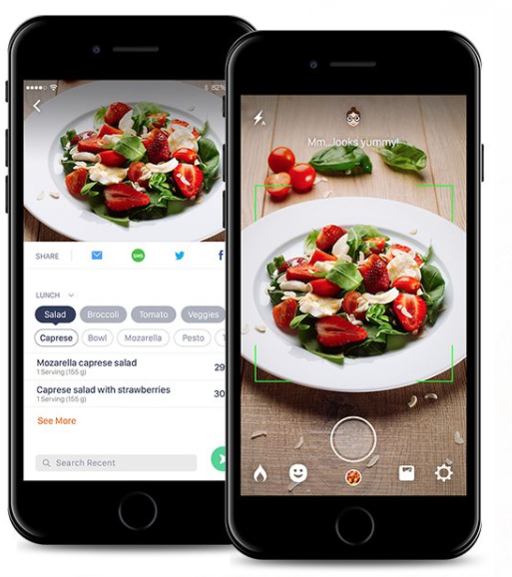
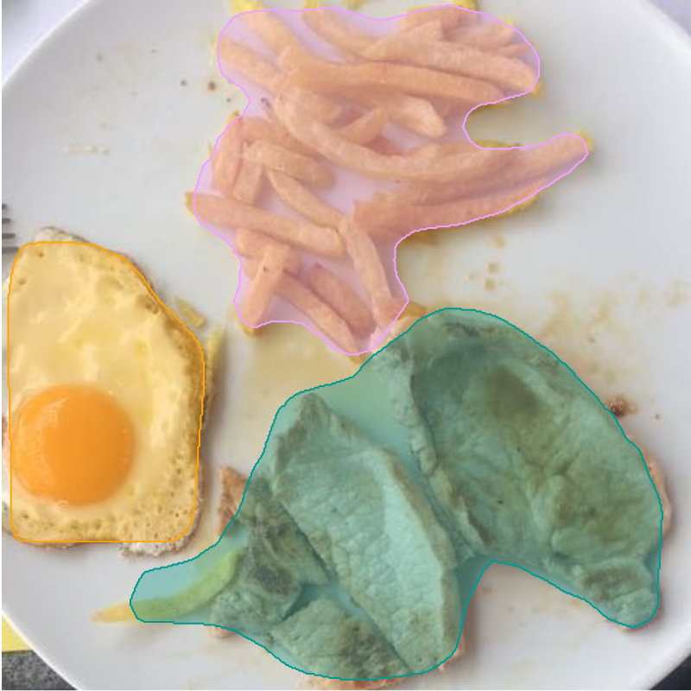
What we expect?

